Slide 1
Lexicographic Min-Max Fairness in Task Assignment
Group 2
Abhinav V S (22008)
Chaitanya Shinde (22085)
Dev Raj Singh (22102)

Slide 2
Introduction
Traditional assignment problems focus on efficiency (minimizing total cost / maximizing utility).
Fairness is critical in multi-agent systems to prevent overburdening individual agents.
Lexicographic min-max fairness (lexifairness): A stronger fairness criterion than min-max fairness. It minimizes the maximum cost, then the second maximum, and so on.
Key Contributionss: - Algorithms for one-to-one and one-to-many assignments. - Tractable approximations for computationally hard problems. - Analysis of efficieny-fairness trade-offs.

Slide 3
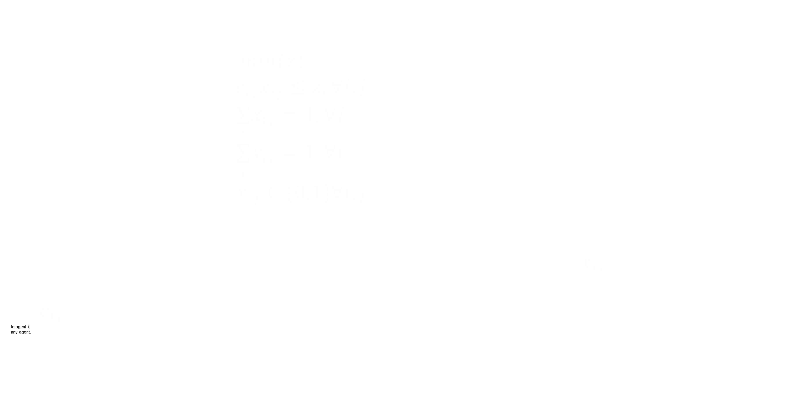
Min-Max Fairness
The goal of min-max fairness is to minimize the maximum cost incurred by any agent. The problem can be formulated as the following optimization problem : $min(z)$ such that, $c_{ij}x_{ij}≤z,∀i,j$ $\underset{i}{∑}x_{ij}=1,∀j$ $\underset{j}{∑}x_{ij}=1,∀i$ $x_{ij}∈\{0,1\}∀i,j$ where, - z is the objective function, representing the highest cost assigned to any agent. - xij is a binary decision variable indicating whether task j is assigned to agent i. $x_{ij}$ij is 1 if agent i performs task j and 0 otherwise. - $c_{ij}$ij is the cost incurred by agent i for performing task j.
to agent i.
any agent.

Slide 4
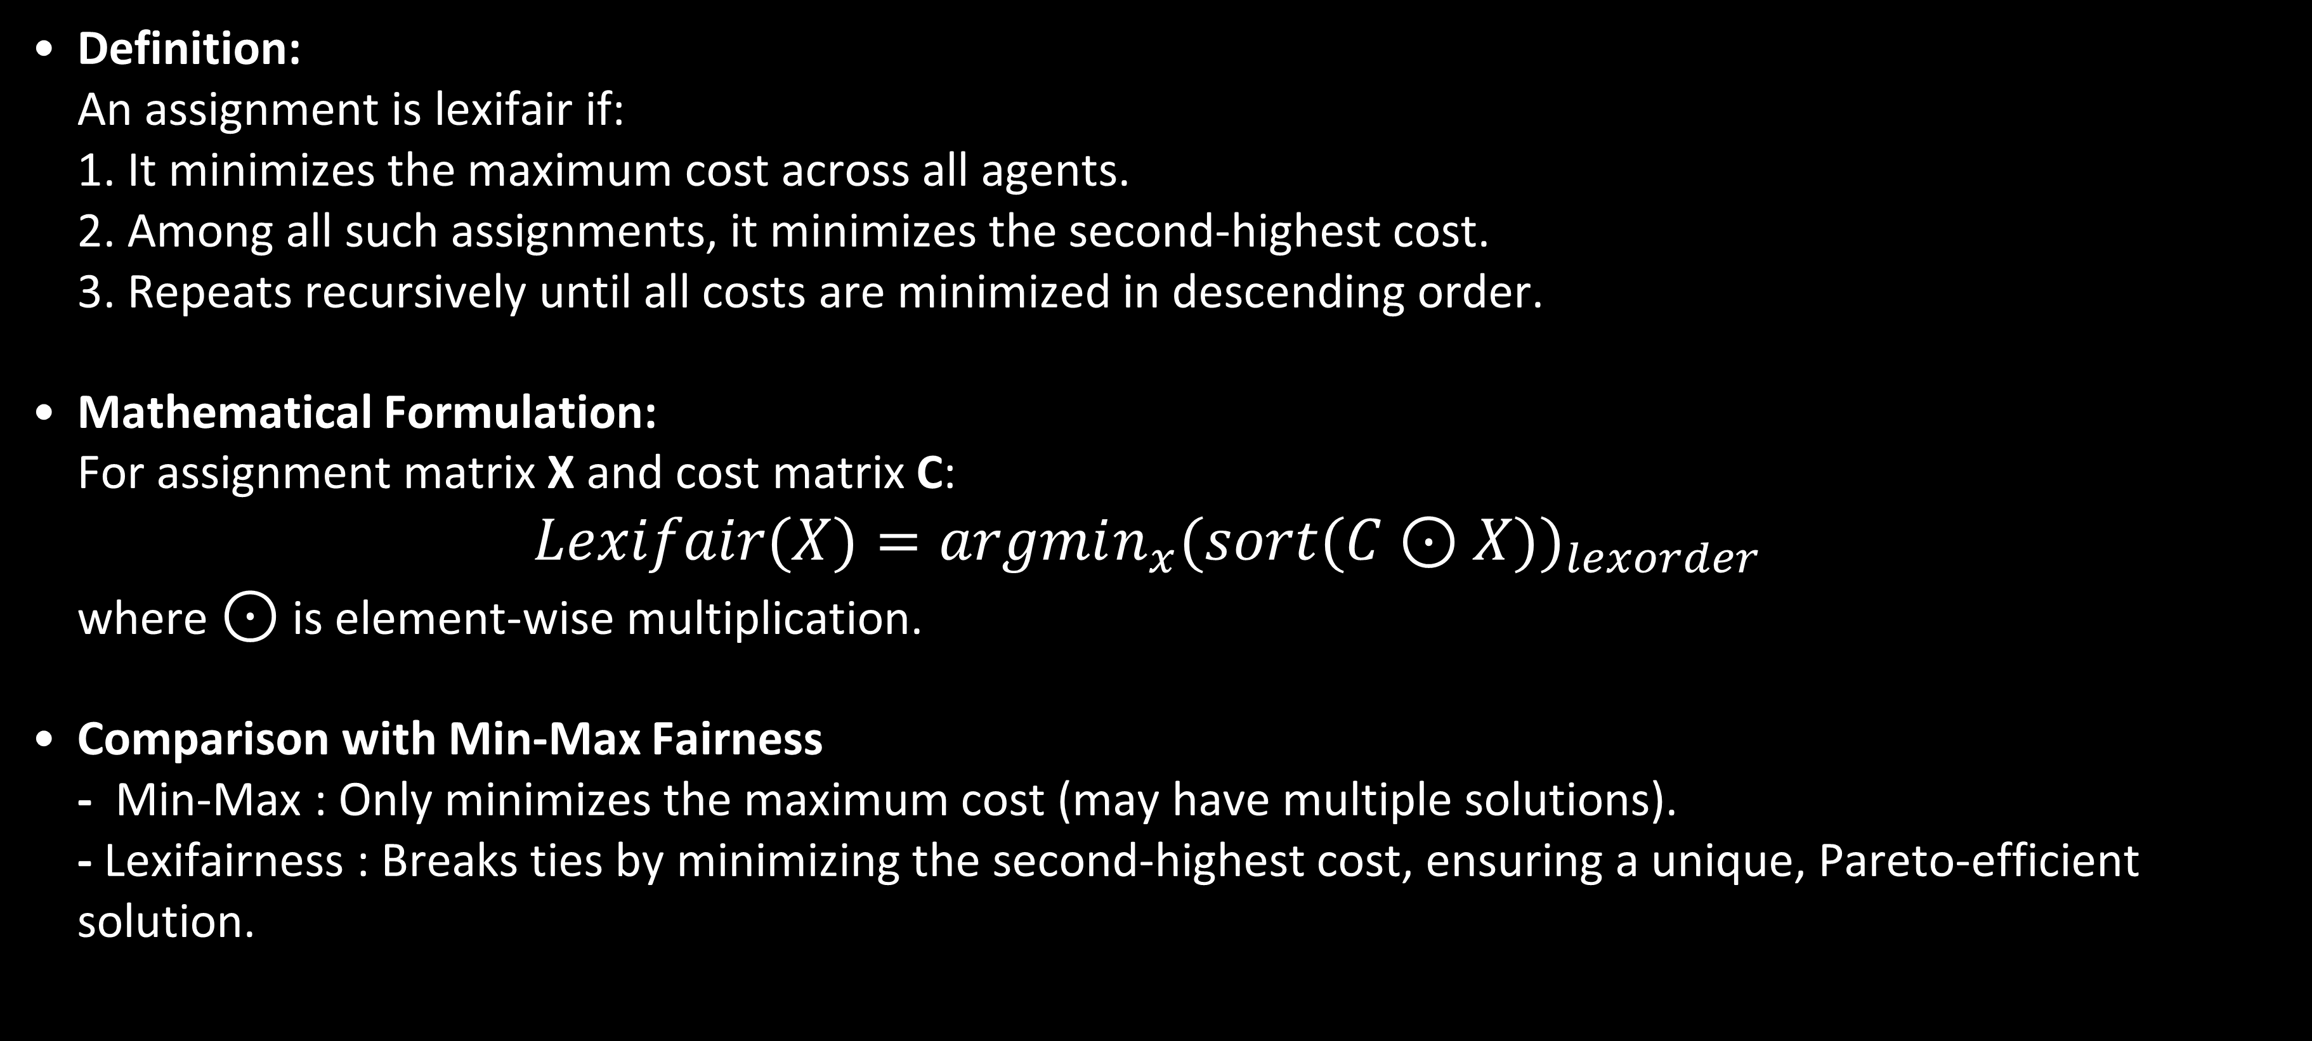
Lexicographic Min-Max Fairness
Definition: An assignment is lexifair if: 1. It minimizes the maximum cost across all agents. 2. Among all such assignments, it minimizes the second-highest cost. 3. Repeats recursively until all costs are minimized in descending order.
Mathematical Formulation: For assignment matrix X and cost matrix C: $Lexifair(X)=argmin_{x}(sort(C⊙X))_{lexorder}$ where $⊙$ is element-wise multiplication.
Comparison with Min-Max Fairness - Min-Max : Only minimizes the maximum cost (may have multiple solutions). - Lexifairness : Breaks ties by minimizing the second-highest cost, ensuring a unique, Pareto-efficient solution.

Slide 5
Algorithms
Algorithm 1 : Iterative Min-Max Optimization 1. Solve a min-max assignment problem. 2. Fix the agent-task pair with the highest cost. 3. Repeat for remaining agents/tasks.
Algorithm 2 : Network Flow Approach Modles assignment as a flow network: 1. Add edges between agents and tasks in ascending cost order. 2. Solve feasibility iteratively using max-flow/min-cut. 3. Fix “bottleneck” edges at each step.
Advantages: - Polynomial time complexity (efficient for large n). - Naturally enforces lexifairness through edge ordering.

Slide 6
Implementation & Results
Iterative Min-Max Optimization (MILP) - Description : Implemented by repeatedly solving a min-max fair assignment problem and fixing the agent-task pair with the highest cost at each iteration. - Implementation Details: The algorithm employs a Mixed Integer Linear Programming solver to find the min-max fair assignment at each iteration. The implementation reassigns the most expensive task to an agent with a lower cost. - Advantages : Easy to understand and implement. - Libraries : PuLP (Python)

Slide 7
Network Flow Approach : - Description : Implemented as a network with agents and task as nodes. Edges are added between agents and tasks based on increasing cost. - Implementation Details : Utilizes a max-flow/min-cut algorithm (e.g., Edmonds-Karp or Dinic’s) to find feasible assignments. Iteratively adds edges until a complete assignment is possible. The final assignment represents the lexifair solution. - Advantages : Polynomial time complexity, scalable for larger problems. - Libraries : NetworkX (Python)
Computational Complexity - MILP : Requires solving n MILP problems, which can be computationally expensive for large n. - Network Flow : Polynomial time complexity, typically O(n^3) , making it more scalable.

Slide 8
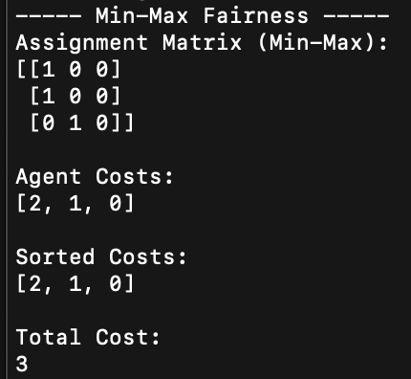
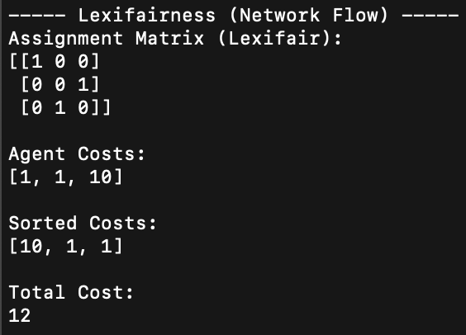
Results and Performance
Comparison of Assignment - Input :Cost matrix (tasks × agents) [ 9, 5, 6] [8, 2, 4] [7, 3, 1]

Slide 9
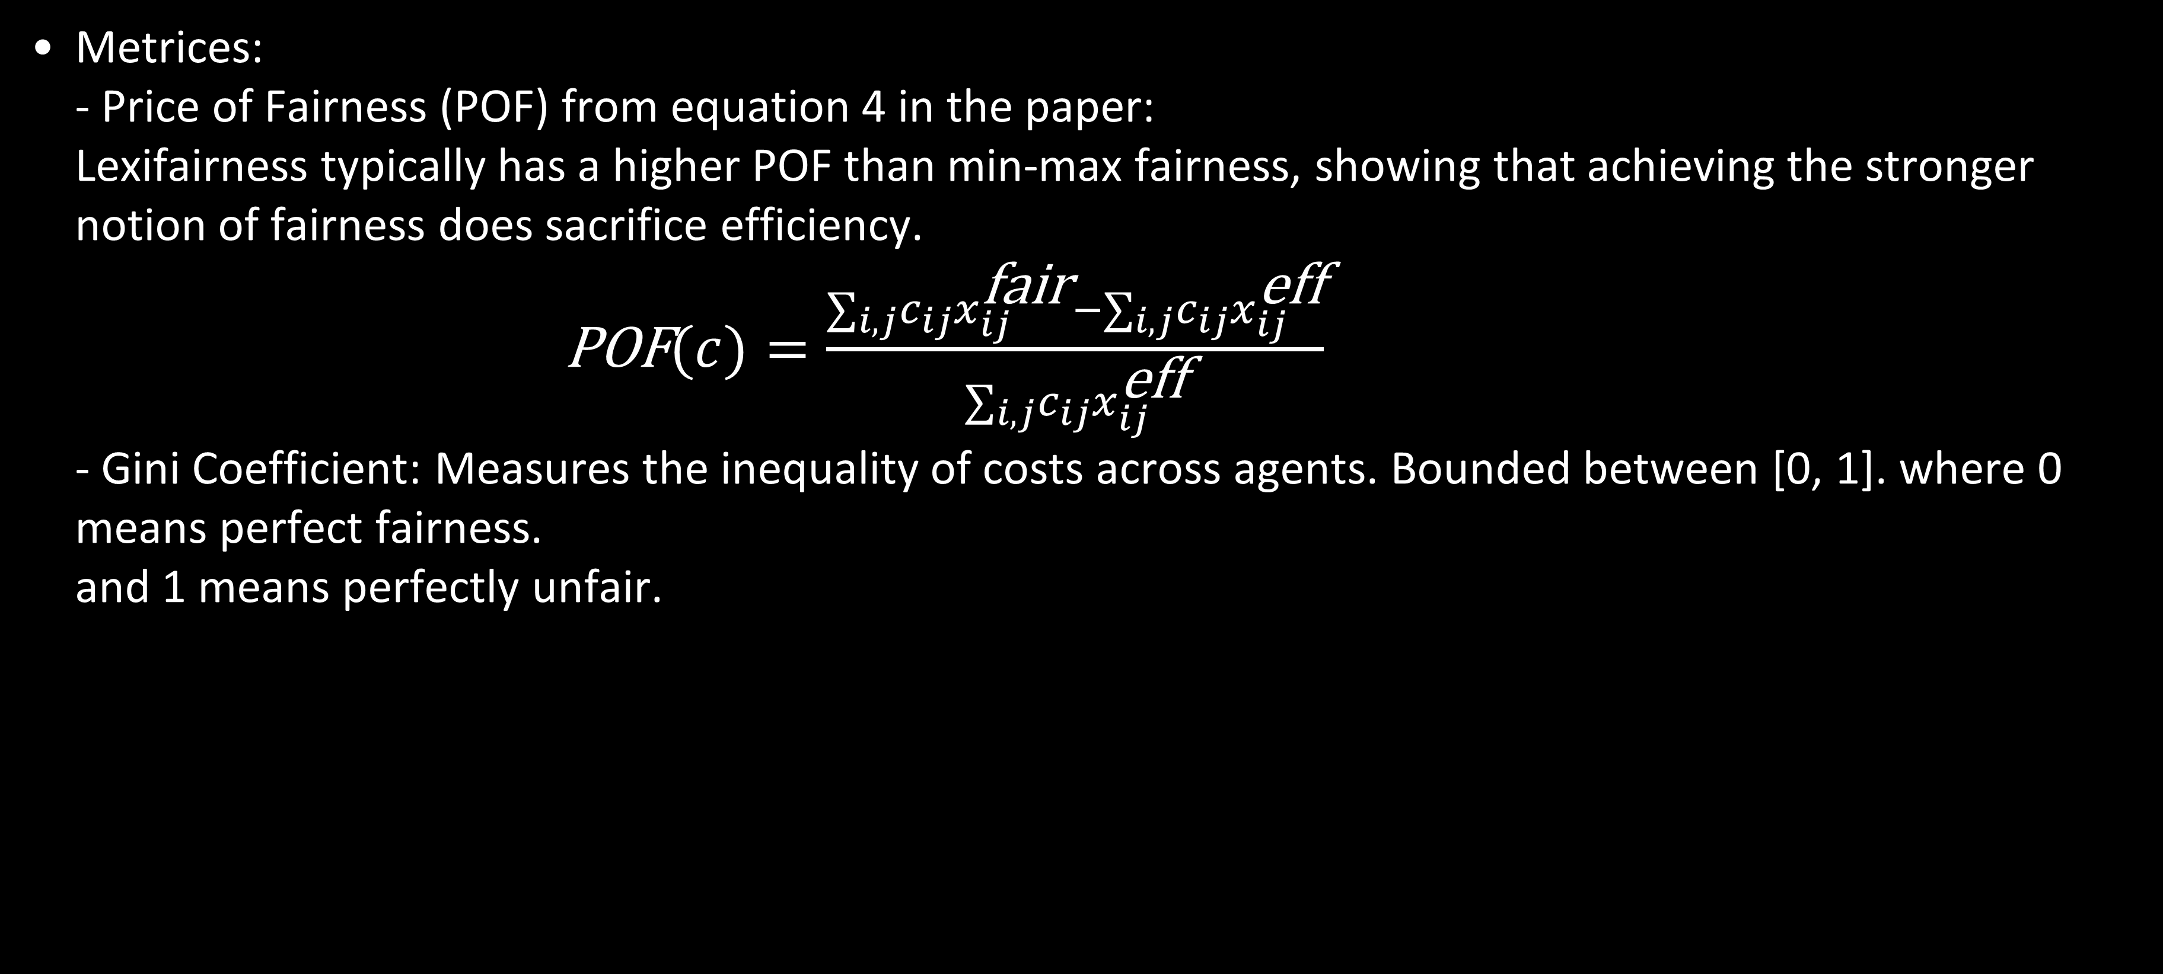
Results and Performance
Metrices: - Price of Fairness (POF) from equation 4 in the paper: Lexifairness typically has a higher POF than min-max fairness, showing that achieving the stronger notion of fairness does sacrifice efficiency. $\text{POF}(c)=\frac{∑_{i,j}c_{ij}x_{ij}^{\text{fair}}−∑_{i,j}c_{ij}x_{ij}^{\text{eff}}}{∑_{i,j}c_{ij}x_{ij}^{\text{eff}}}$ - Gini Coefficient: Measures the inequality of costs across agents. Bounded between [0, 1]. where 0 means perfect fairness. and 1 means perfectly unfair.

Slide 10
Results and Performance
Efficient Assignment : Minimizes total cost but may have no fairness(e.g. [9, 2, 1]).
Min Max Assignment : (e.g. [7, 2, 6])
Lexifair Assignment : (e.g. [7 , 5, 4])
Case Study : One-to Many Assignments Challenge : NP-hard for large m != n. Approximation: Partition tasks into groups, Apply lexifairness to each group iteratively Result : Near - lexifair solutions with reduced computation.

